Slide 1

A web-based Applicant Tracking System that automates resume screening by comparing candidate resumes with job descriptions using intelligent keyword-based matching.
Resume Screening System (ATS)
Name :
Roll Number :
Department :
N.Chinmaya Sai
23AK1A0532
Computer Science & Engineering

Slide 2

Problem Statement
Time-consuming
Manual screening requires many hours for every job opening
High volume
Recruiters receive large numbers of
heterogeneous applications.
Poor filtering
Quickly identifying suitably skilled candidates is difficult.
Need for automation
A simple, reliable system is required to prioritise candidates efficiently.

Slide 3
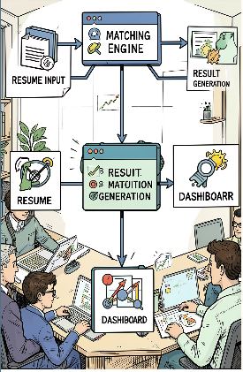
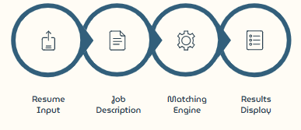
Methodology
Modules:
Resume Input Module — file upload / text parsing.
Job Description Input Module — enter or paste JD text.
Matching Engine — normalise text, count keyword overlaps, compute match score.
Result Module — ranked list, matched keywords highlighted, explorable report

Slide 4
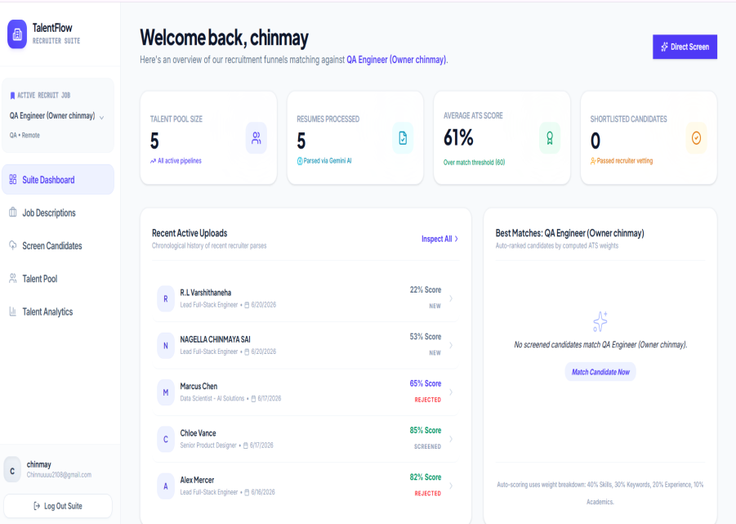
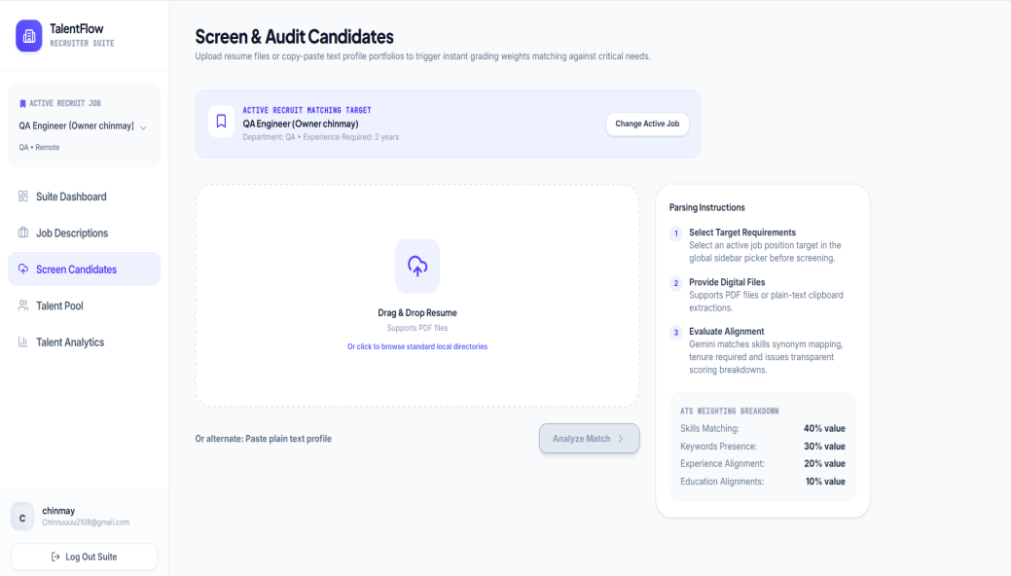
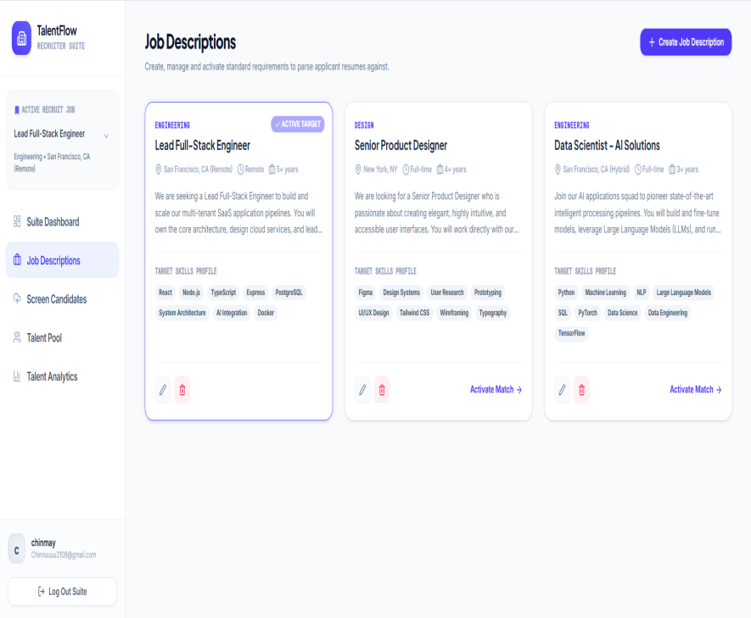
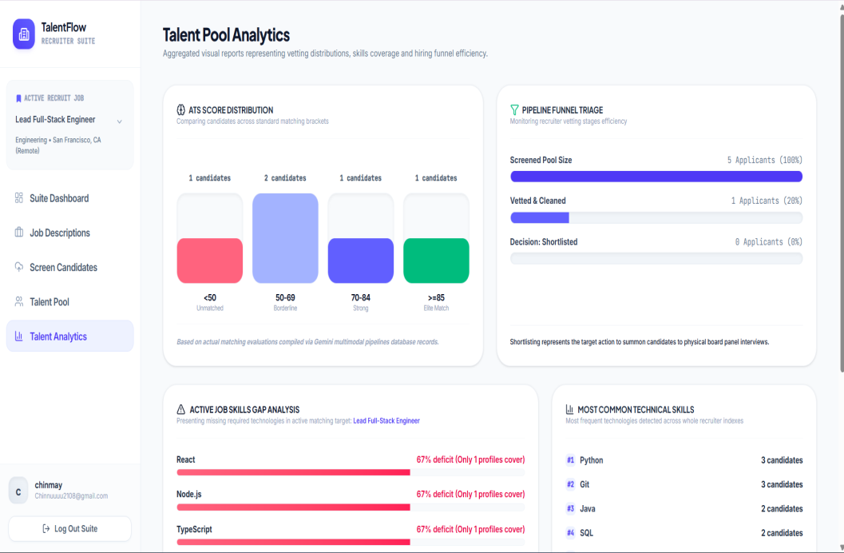
Snapshots of MVP

Slide 5


Tech Stack & Conclusion
Fron Frontend — ReactJS
Dynamic, component- based user interface for resume and job description input
Backend -Node.js & Express
Deployment — Render
Cloud hosting for seamless continuous
deployment and accessibility
RESTful API handling resume parsing and keyword matching logic
Automation
Efficiency
Future Scope
System automates basic resume screening end-to-end
Saves time and improves hiring process throughput
Can be enhanced with AI and NLP for deeper analysis

Slide 6
Links:
1. Github Repository : https://github.com/nagellachinmayasai-code/Mini-Project
2. MVP Link : https://mini-project-444l.onrender.com/

Slide 7


